Slide 1

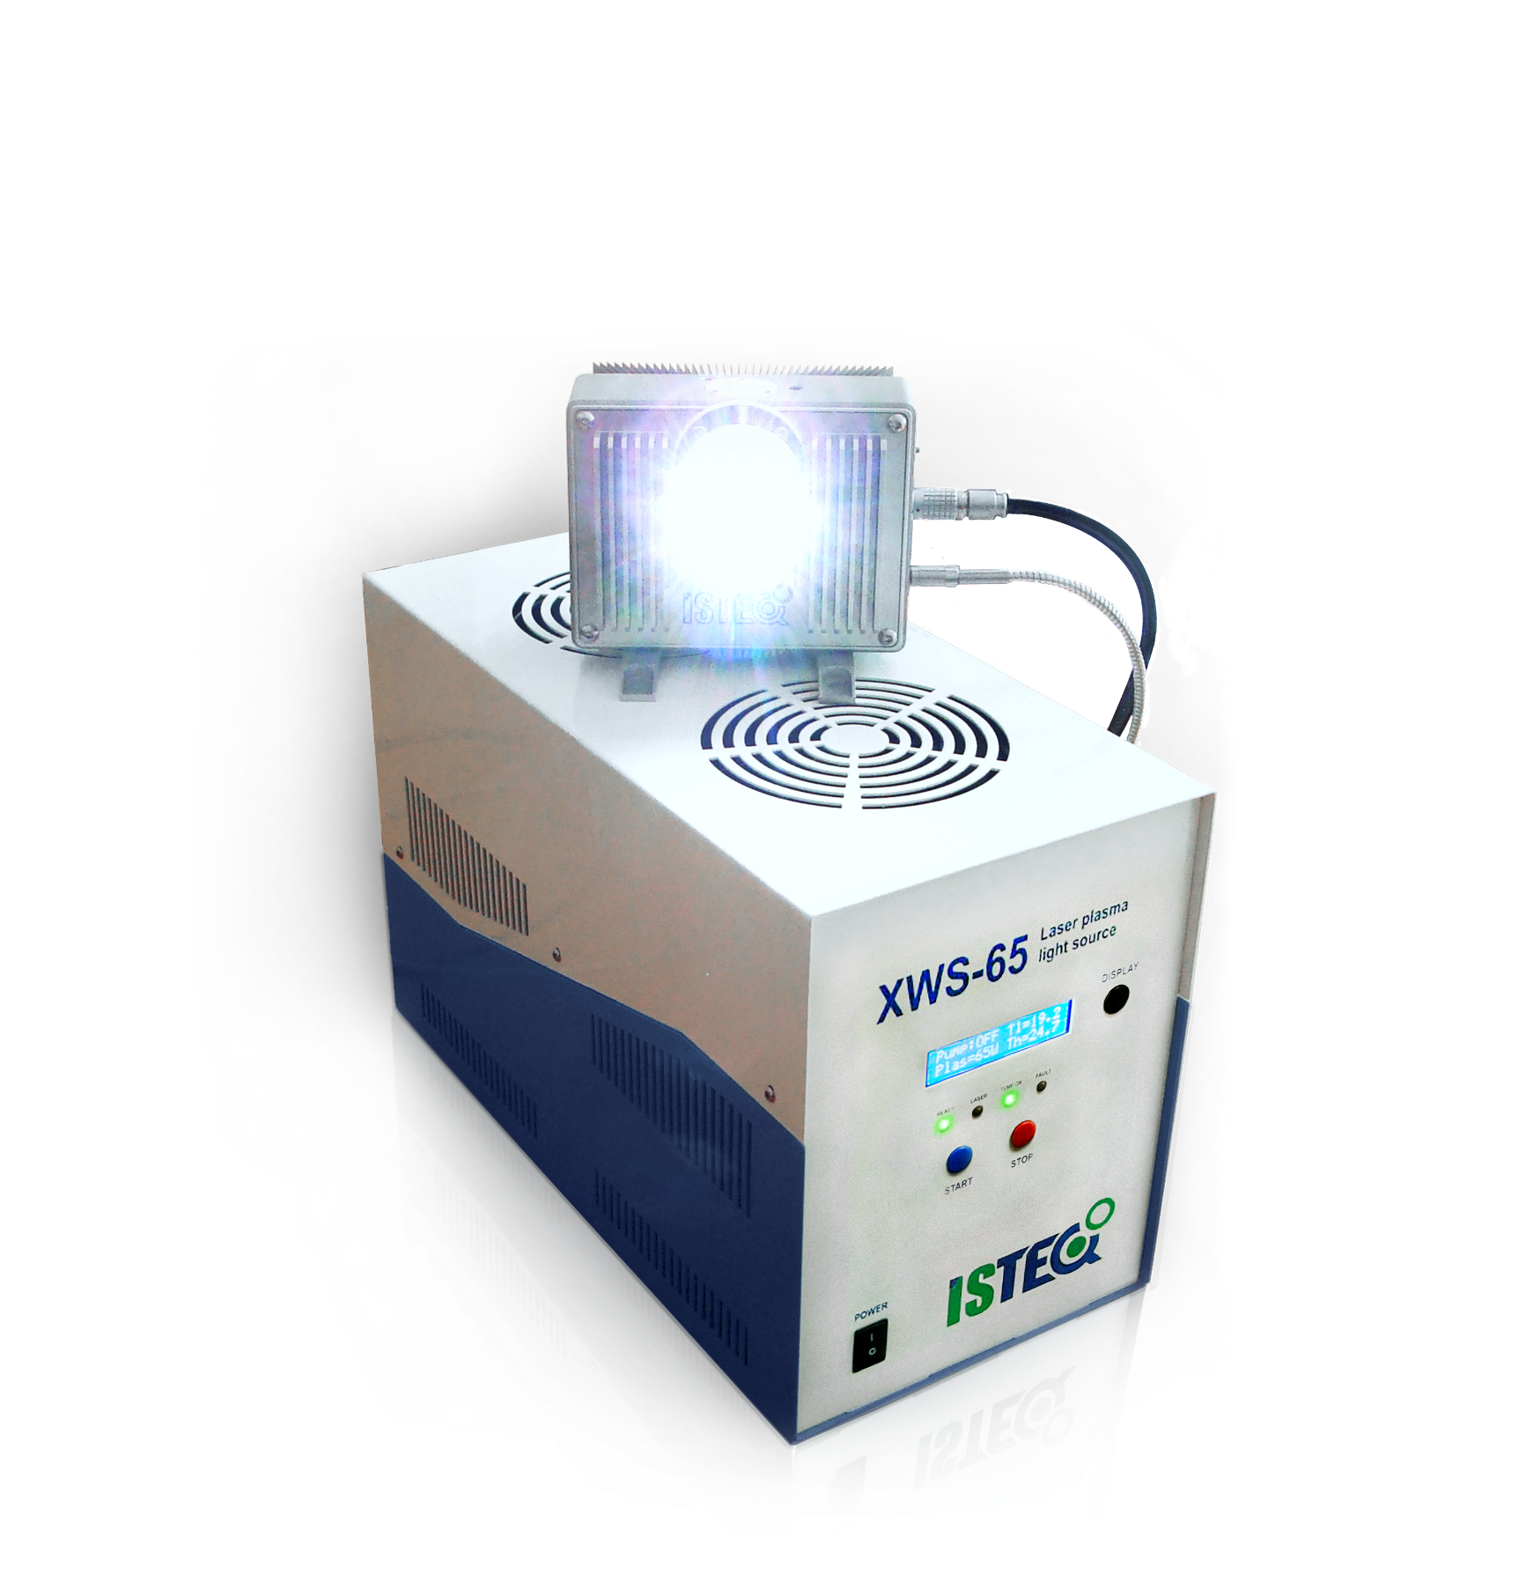
ISTEQ Broadband plasma light sources
XWS-65: Basic configuration
XWS-Dual port: Two light outputs
XWS-X: Ultra high brightness
XWS-X: Ultra high brightness
XWS-30: Compact light source
Hyperchromator: Tunable light source

Slide 2
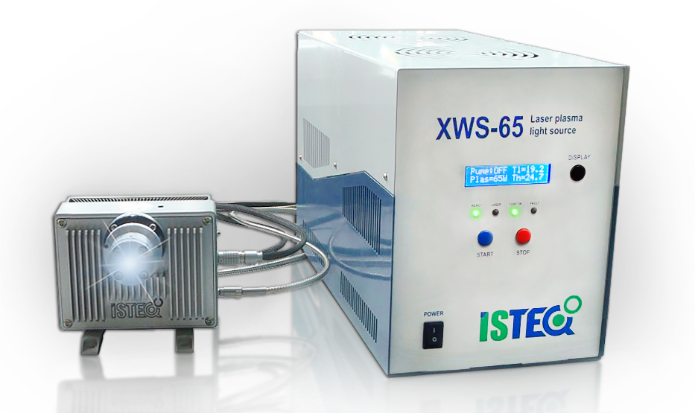


Light sources
XWS-65 broadband plasma light source
XWS-65 laser pumped plasma ultrabright broadband light source
ISTEQ’s XWS-65 light source product has been specially developed to be used for a variety of applications, including spectroscopy, high resolution microscopy, thin - film measurement, surface metrology and others. This source is based on cutting edge technology, covered by EU and US patents.
Application fields:
Absorption and fluorescence spectroscopy
Diagnostics systems in microelectronics - contamination and defect control
Surface metrology, ellipsometry and scatterometry
Microscopy, including confocal and fluorescence
Optical component testing
Detectors in chromatography, microfluidics, lab-on-a-chip, droplet spectrometers, cytofluorimeters, etc
Main advantages:
CW laser plasma discharge
Broad spectral range: 190 – 2500 nm
High spectral brightness: up to 50 mW/(mm²·sr·nm)
High temporal and spatial stability: STD<0.15%
Long life time due to electrodeless operation: 10,000 hours
The small dimensions of the emitting volume considerably expand the range of XWS applications
External source control and parameters monitoring via Software, Windows GUI
Spectral brightness of XWS-65 light source
in UV and VIS spectral region

Slide 3
Light sources
XWS-65 broadband plasma light source
XWS-65 performance
Spectral range | 190 - 2500nm for UV configuration, 250 - 2500nm for OFR configuration
Spectral brightness | Up to 50mW/(mm²·sr·nm)
Output power | Up to 3 W free space Up to 0.5 W via fiber
Lamp medium | Xenon
Emitting body size | 250×500um
Lifetime | 10,000 hours
Temporal and spatial stability | STD < 0.15%
Optical design
Output NA by default | 0.4, up to 0.55 upon request
External optic interface by default | C-mount
Optional output interface | Thorlabs SM1, 30mm cage and more
Fiber interface (only for FCU version) | SMA or FC
Optional configurations
Source spectrum | UV or Ozone free
Light output | Free space or fiber coupled
Optical head cooling unit | Air or water cooling
Power Supply Unit (PSU) cooling system | Air or water cooling
Additional
Connection to PC/Laptop | Ethernet (Web interface), COM-port (RS232)
Interlock | Db-15 connector
Remote plasma control | Db-15 connector
System dimensions and weight
Optical head Free Space | 130 × 110 × 74mm, 1.3kg
Power supply unit | 351 × 172 × 232mm, 8kg
Facility requirements
Electrical | 100-240V, 50/60Hz
Gas purging (only for UV configuration) | Nitrogen or Argon purging, 1l/min

Slide 4
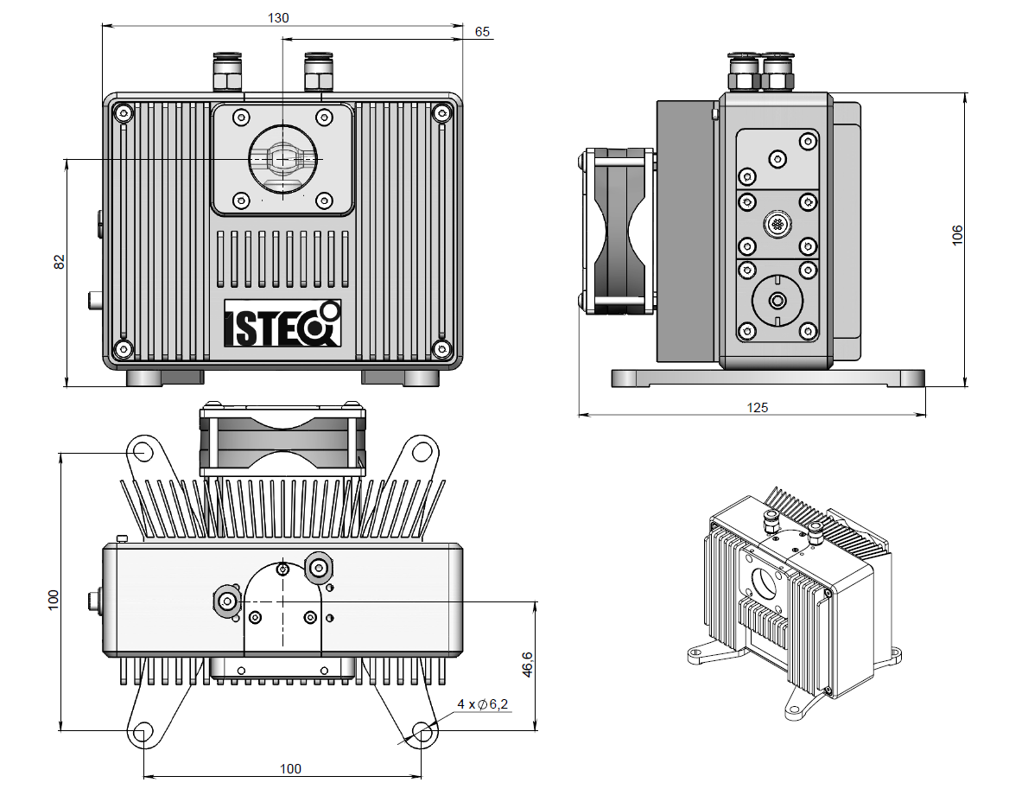
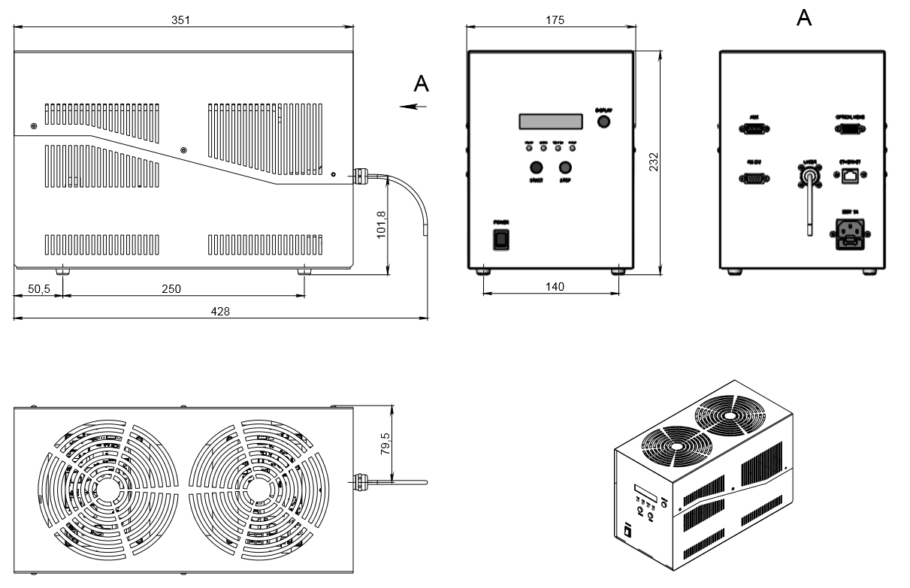
Light sources
XWS-65 broadband plasma light source
Optical head (Free Space) dimensions:
Power Supply Unit (PSU) dimensions:

Slide 5
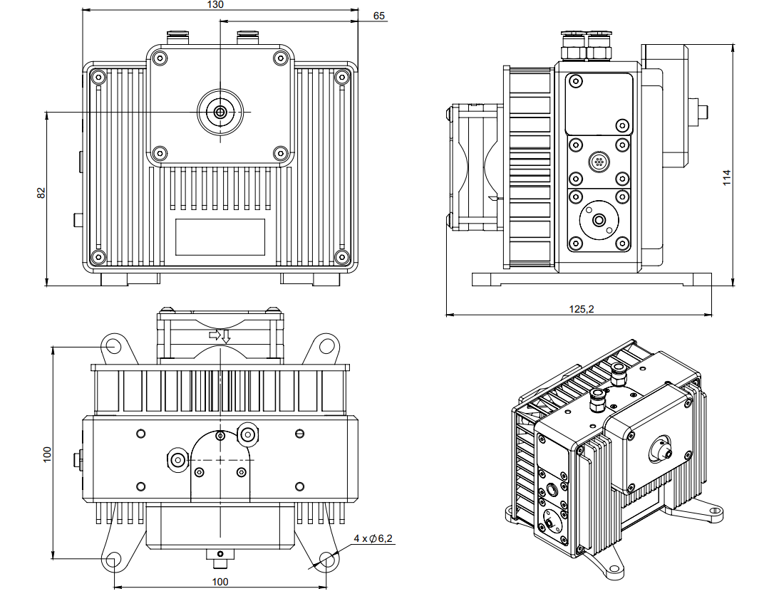
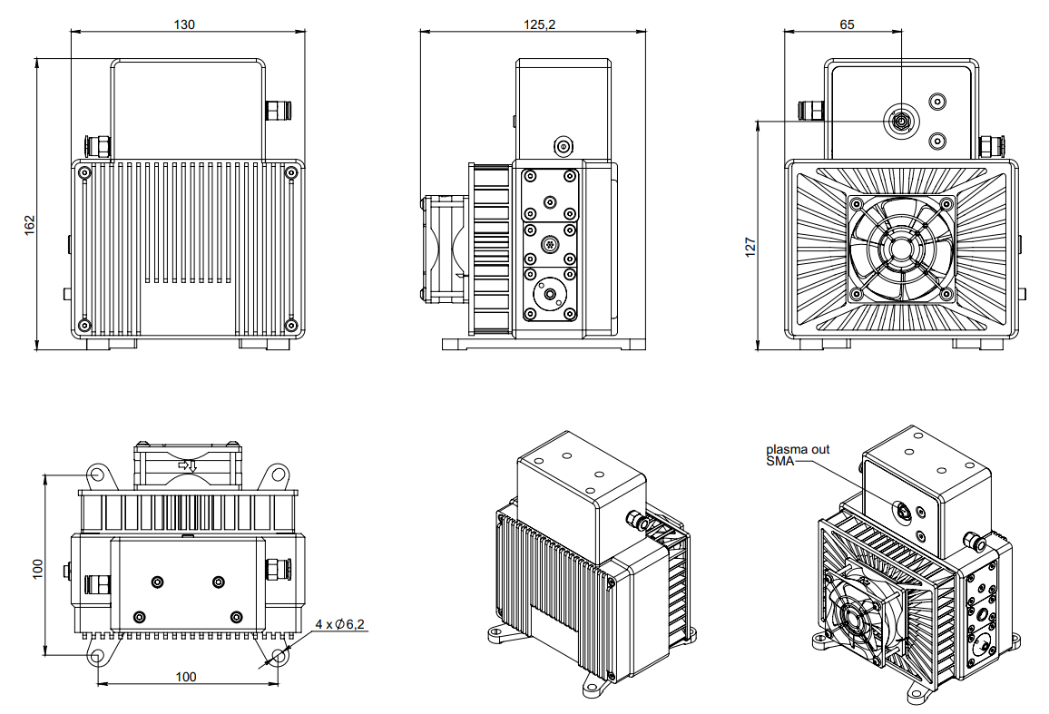
Light sources
XWS-65 FCU broadband plasma light source
XWS-65 OFR FCU configuration:
XWS-65 UV FCU configuration:

Slide 6
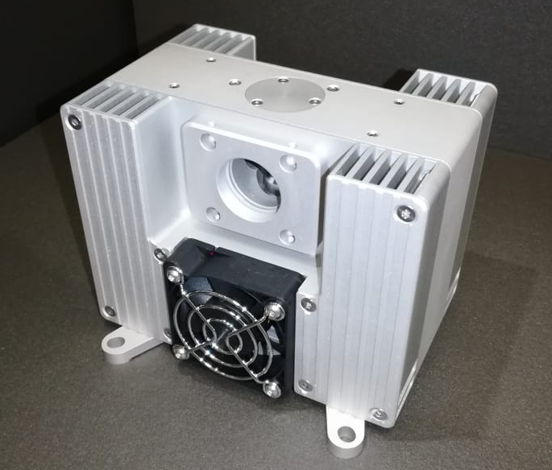
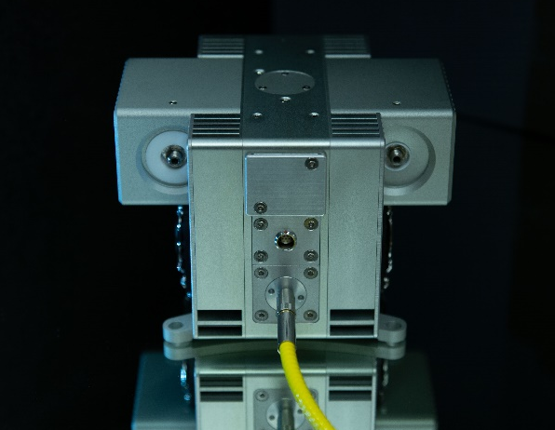
Light sources
XWS-Dual port: Free space and FCU versions
XWS Dual port Free Space
XWS Dual port FCU
Special features:
Dual beam light source with identical parameters for each port
Developed on XWS-65 base
Spectral brightness: up to 50 mW/(mm2·sr·nm)
High stability: STD <0.15%
FCU version:
SMA or FC fiber interface
Output power up to 0.5W after each fiber
Spectral brightness of XWS-Dual port light source
in UV and VIS spectral region

Slide 7
Light sources
XWS-Dual port: Free space and FCU versions
XWS-Dual port performance
Spectral range | 190 - 2500nm for UV configuration, 250 - 2500nm for OFR configuration
Spectral brightness | Up to 50mW/(mm²·sr·nm)
Output power | Up to 3 W free space per port Up to 0.5 W via fiber per port
Lamp medium | Xenon
Emitting body size | 250×500um
Lifetime | 10,000 hours
Temporal and spatial stability | STD < 0.15%
Optical design
Output NA by default | 0.4, up to 0.55 upon request
External optic interface by default | C-mount
Optional output interface | Thorlabs SM1, 30mm cage and more
Fiber interface (only for FCU version) | SMA or FC
Optional configurations
Source spectrum | UV or Ozone free
Light output | Free space or fiber coupled
Optical head cooling unit | Air cooling
Power Supply Unit (PSU) cooling system | Air or water cooling
Additional
Connection to PC/Laptop | Ethernet (Web interface), COM-port (RS232)
Interlock | Db-15 connector
Remote plasma control | Db-15 connector
System dimensions and weight
Optical head FCU | 130 × 154 × 74mm, 2kg
Power supply unit | 351 × 172 × 232mm, 8kg
Facility requirements
Electrical | 100-240V, 50/60Hz
Gas purging (only for UV configuration) | Nitrogen or Argon purging, 1l/min

Slide 8
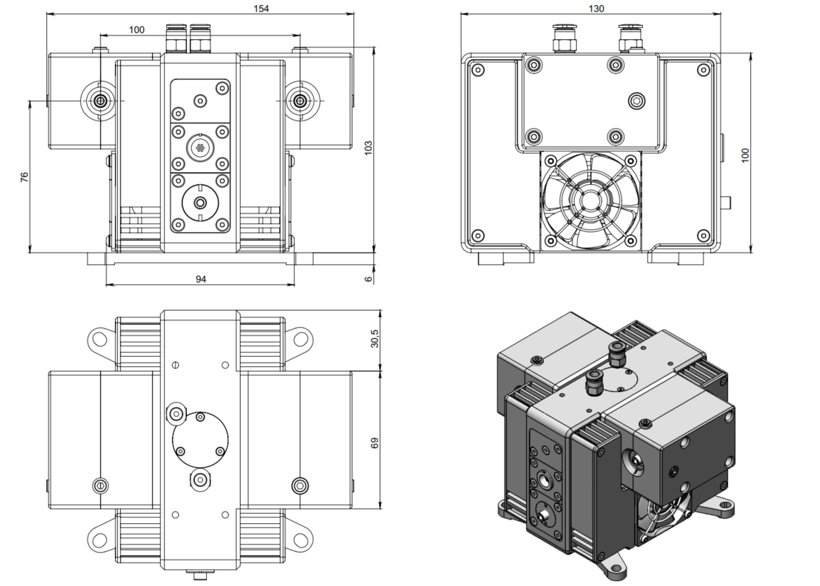
Light sources
XWS-Dual port FCU
Optical head dimensions:
Power Supply Unit (PSU) dimensions:

Slide 9
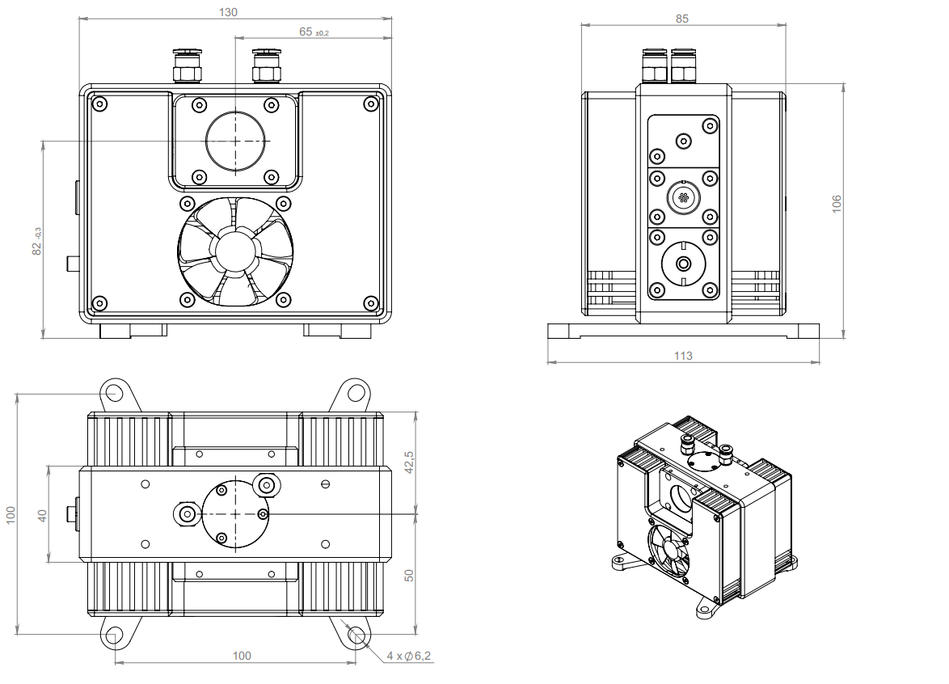
Light sources
XWS-Dual port Free Space
Optical head dimensions:
Power Supply Unit (PSU) dimensions:

Slide 10
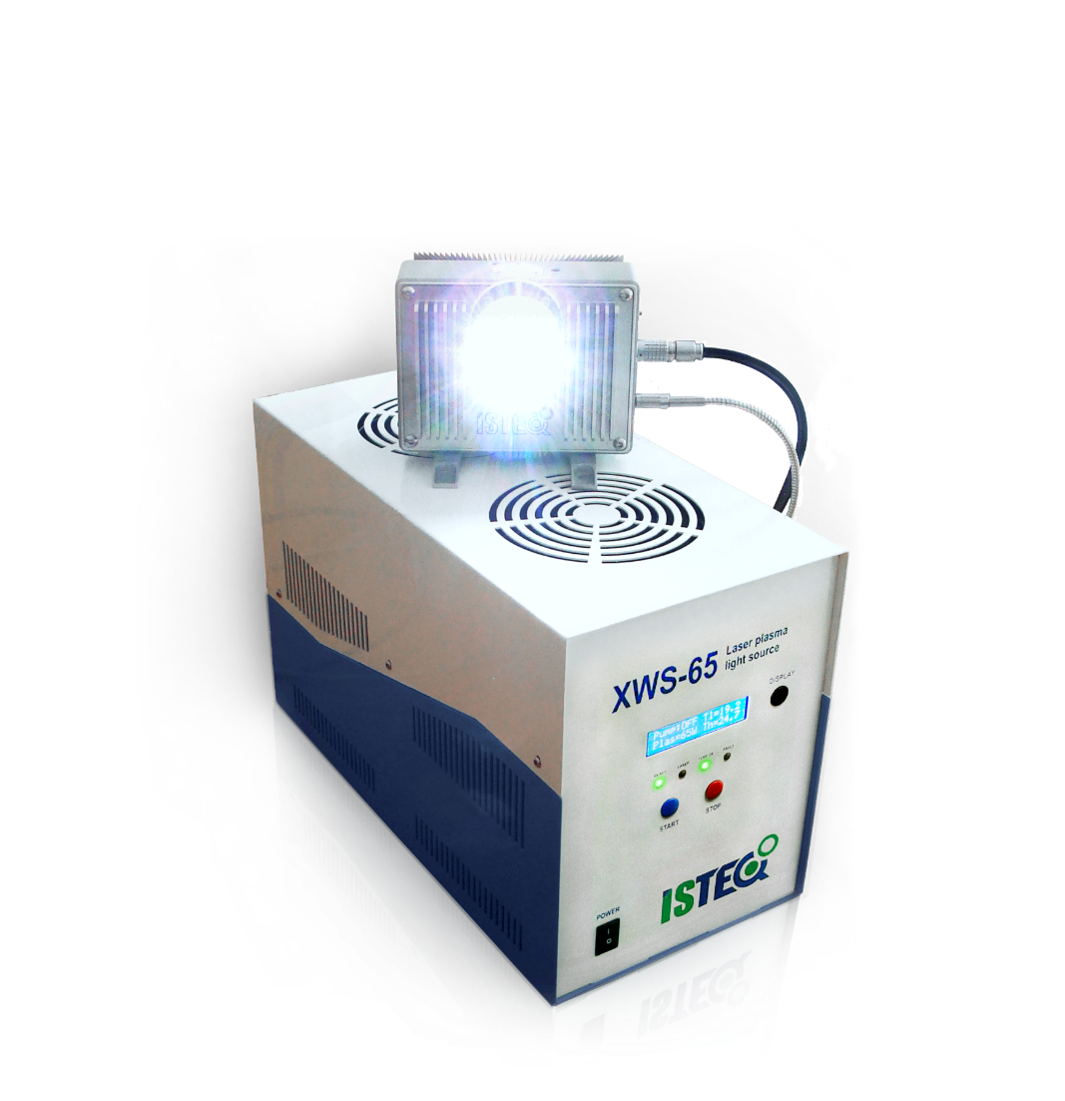
Light sources
XWS-X high UV light source
ISTEQ’s XWS-X light source product has been specially developed for those customers, who needs a powerful light source with a high UV generation.
Special features:
Significantly higher brightness across the whole spectral range in comparison to XWS-65
Maximum spectral brightness up to 120mW mW/(mm2·sr·nm)
X6 brightness improvement at UV range below 250nm in comparison to XWS-65
Output configuration: Free space or FCU
Available in Dual Port configuration
Available in XR (High power) configuration with a maximum brightness up to 200mW/(mm2·sr·nm)
Spectral brightness of XWS-X light source
in UV and VIS spectral region

Slide 11
Light sources
XWS-X high power light source
XWS-X performance
Spectral range | 190 - 2500nm for UV configuration, 250 - 2500nm for OFR configuration
Spectral brightness | Up to 120mW/(mm²·sr·nm)
Output power | Up to 3 W free space Up to 0.6 W via fiber
Lamp medium | Xenon
Emitting body size | 250×500um
Lifetime | 10,000 hours
Temporal and spatial stability | STD < 0.15%
Optical design
Output NA by default | 0.4, up to 0.55 upon request
External optic interface by default | C-mount
Optional output interface | Thorlabs SM1, 30mm cage and more
Fiber interface (only for FCU version) | SMA or FC
Optional configurations
Source spectrum | UV or Ozone free
Light output | Free space or fiber coupled
Optical head cooling unit | Air cooling
Power Supply Unit (PSU) cooling system | Air or water cooling
Additional
Connection to PC/Laptop | Ethernet (Web interface), COM-port (RS232)
Interlock | Db-15 connector
Remote plasma control | Db-15 connector
System dimensions and weight
Optical head FCU | 130 × 110 × 74mm, 1.8kg
Power supply unit | 351 × 172 × 232mm, 8kg
Facility requirements
Electrical | 100-240V, 50/60Hz
Gas purging (only for UV configuration) | Nitrogen or Argon purging, 1l/min

Slide 12
Light sources
XWS-X broadband plasma light source
Optical head (Free Space) dimensions:
Power Supply Unit (PSU) dimensions:

Slide 13
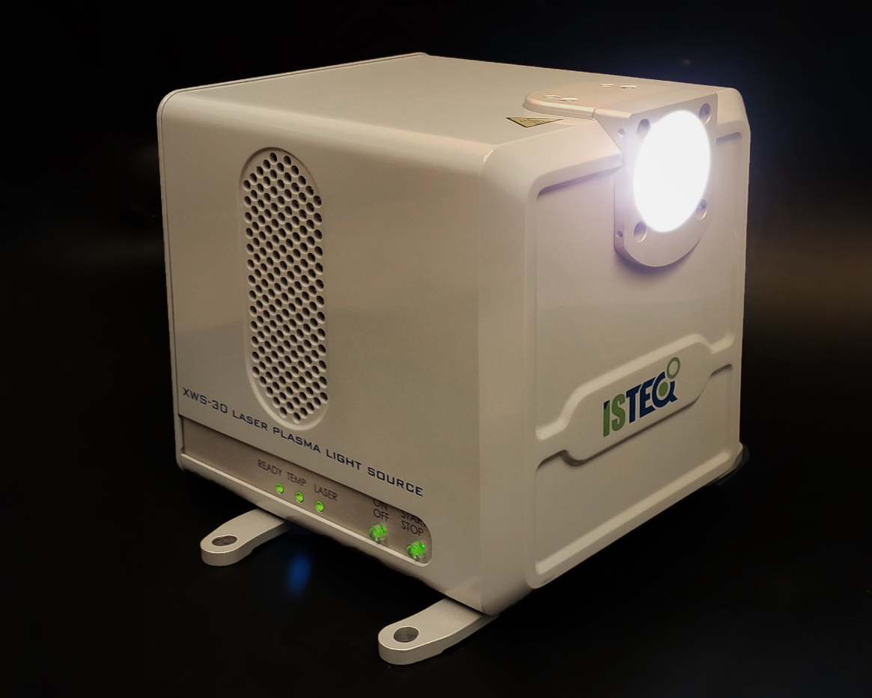
Light sources
XWS-30 compact light source
ISTEQ’s XWS-30 light source product has been specially developed for those customers, who needs super compact broadband light source with low heat dissipation, keeping the plasma brightness high.
Special features:
Unique concept of a compact “all in one” source
Very compact: 110x110x120mm, no external chiller
Spectral brightness: up to 40 mW/(mm2·sr·nm)
Output configuration: Free space or FCU
Full system control by Laptop/PC via USB-RS485 adapter
Spectral brightness of XWS-30 light source
in UV and VIS spectral region

Slide 14
Light sources
XWS-30 high power light source
XWS-30 performance
Spectral range | 190 - 2500nm for UV configuration, 250 - 2500nm for OFR configuration
Spectral brightness | Up to 40mW/(mm²·sr·nm)
Output power | Up to 1.5 W free space Up to 0.4 W via fiber
Lamp medium | Xenon
Emitting body size | 100×200um
Lifetime | 10,000 hours
Temporal and spatial stability | STD < 0.15%
Optical design
Output NA by default | 0.5, up to 0.55 upon request
External optic interface by default | C-mount
Optional output interface: | Thorlabs SM1, 30mm cage and more
Fiber interface (only for FCU version) | SMA or FC
Optional configurations
Source spectrum | UV or Ozone free
Light output | Free space or fiber coupled
Optical head cooling unit | Air cooling
Additional
Connection to PC/Laptop | COM-port (RS485) or USB
Interlock | Lemo FG
System dimensions and weight
Optical head | 110 × 110 × 120mm, 2kg
Facility requirements
Electrical | 100-240V, 50/60Hz
Gas purging (only for UV configuration) | Nitrogen or Argon purging, 1l/min

Slide 15
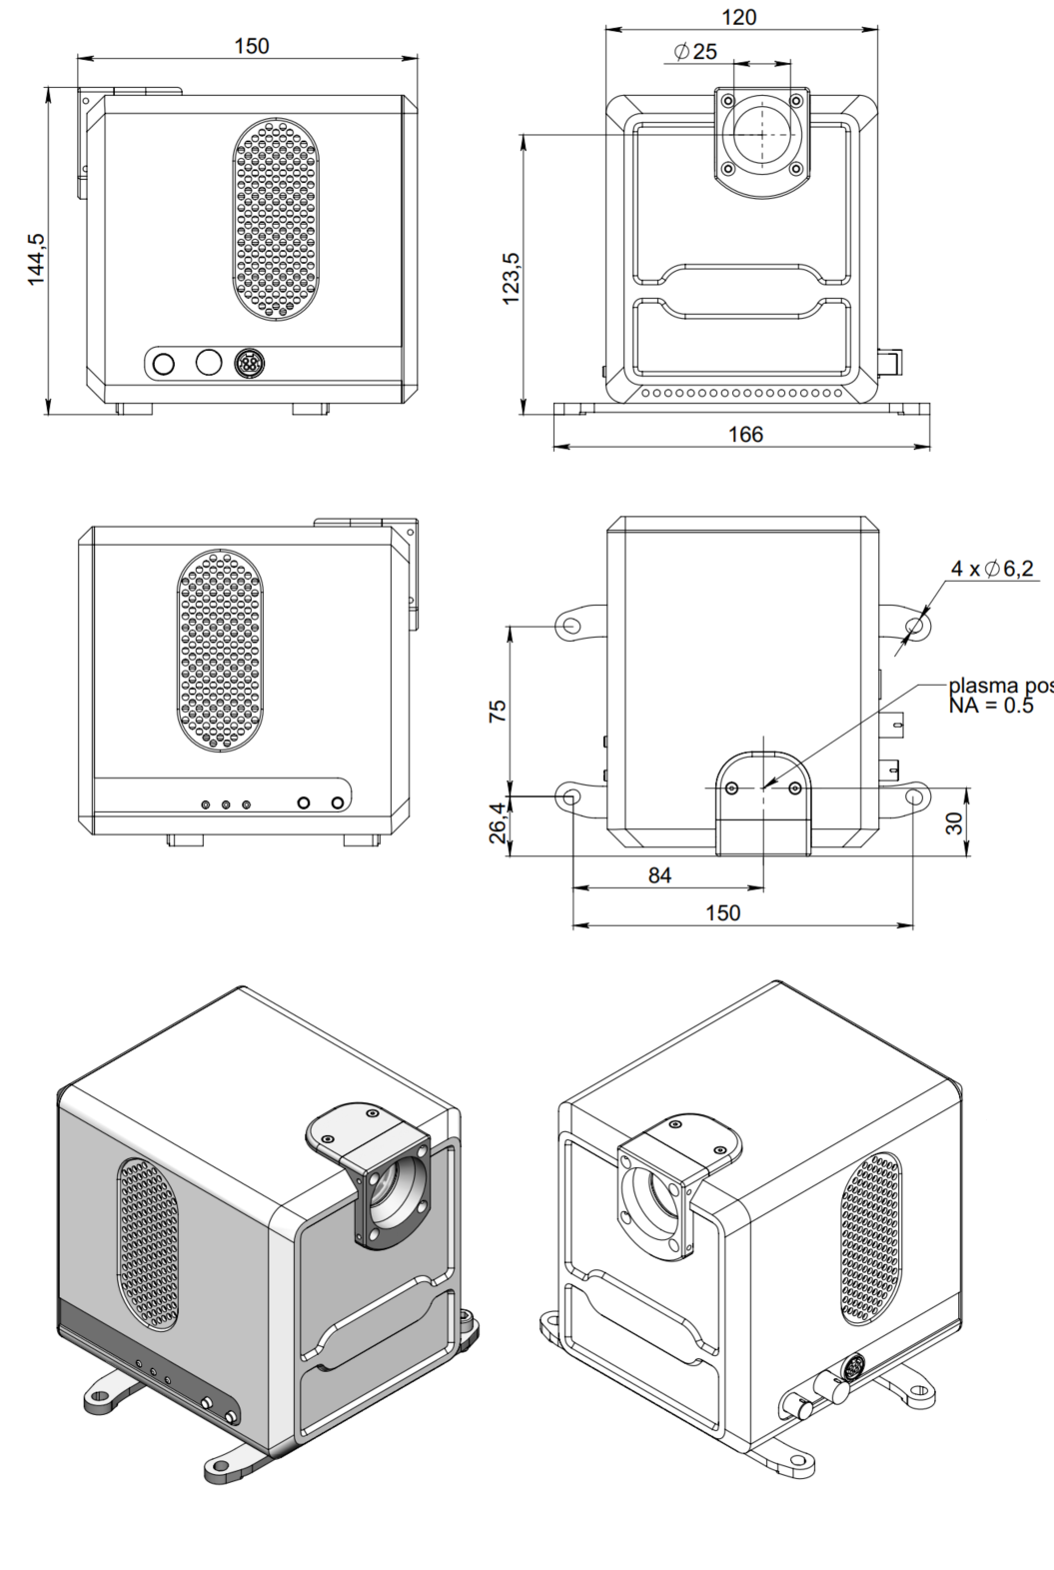
Light sources
XWS-30 compact light source
Plasma position, NA = 0.5

Slide 16


Light sources
XWS specifications
 | XWS-30 | XWS-65 | XWS-R | XWS-X
Spectral range for UV/OFR: | 190 - 2500nm / 250 - 2500nm
Maximum spectral brightness | 40mW/(mm²·nm·sr) | 50mW/(mm²·nm·sr) | 90mW/(mm²·nm·sr) | 120mW/(mm²·nm·sr)
Output power | Up to 1.5W free space Up to 0.4W via fiber | Up to 3W free space Up to 0.5W via fiber | Up to 5W free space Up to 1W via fiber | Up to 3W free space Up to 0.6W via fiber
Emitting body size | 100×200um | 250x500um | 250×700um | 250×500um
Lifetime | 10,000 hours
Temporal and spatial stability | STD < 0.15%
Optical design
Output NA (by default) | 0.5 | 0.4 | 0.4 | 0.4
Maximum NA (upon request) | 0.55
External optic interface | C-mount, 30 Thorlabs cage
Optional configurations
Source spectrum | UV or Ozone free
Light output | Free space or fiber coupled
Additional features
External control | COM-port (RS-485) | COM-port (RS-232) | COM-port (RS-232)
Interlock / Distant plasma control | Lemo FGG | Db-15 connector
Dimensions
Optical head dimensions | 138x110x148mm | 130x75x106mm | 130x110x106mm | 130x75x106mm
Power supply dimensions | NA (No power supply) | 351x175x232mm | 351x175x232mm | 351x175x232mm
Available configurations
 | Output configuration |  | Cooling system
 | Dual Port Output | UV/OFR FCU | Water Cooled Optical Head | Air Cooled PSU | Water Cooled PSU | Air Cooled PSU
XWS-30 |  |  |  |  | N/A | N/A
XWS-65
XWS-X
Custom design
Upon a request that is possible to modify ISTEQ serial product to meet customer requirements.

Slide 17
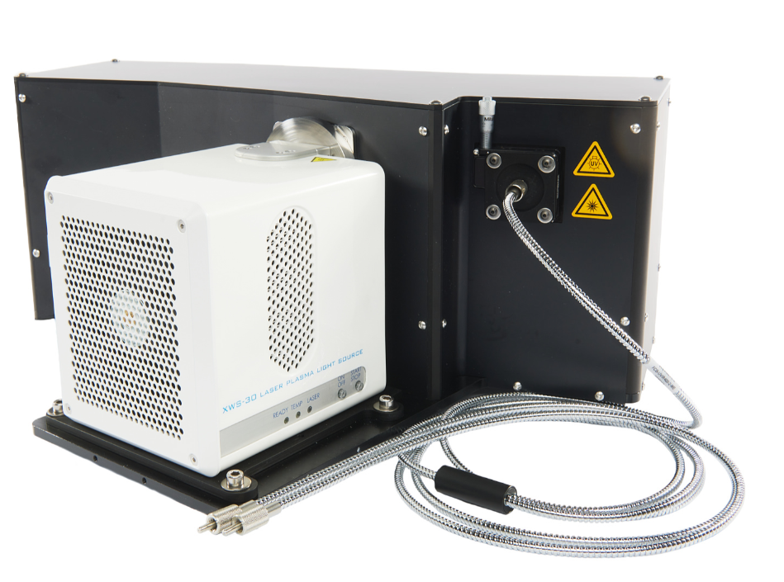

Light sources
Hyperchromator – tunable light source
The Hyperchromator - «Mountain Instruments» monochromator designed by for ISTEQ’s laser-pumped plasma light source XWS-30. The Hyperchromator optimally uses the advantages of the pointed plasma light source by using a mirror with an aperture up to f/1.5 to collect the light and ensure maximum light throughput without a limiting entrance slit. It is optimized for applications that require a fast and tunable point light source.
Special features:
Different configurations available
Fast optics, up to f/1.5 for highest throughput
Homogenous output distribution due to a proprietary design
Etendue-matched to ISTEQ XWS-30
Broad tunable range from DUV to NIR
No input slit
Built-In Shutter
Easy to use Software, Windows GUI
LabView integration upon request
Power Hyperchromator II 400µm fiber with NA=0.22

Slide 18
Light sources
Hyperchromator – tunable light source
Hyperchromator performance
Optical input | ISTEQ XWS-30 light source, directly coupled (optionally other sources)
Optical output | Fused silica fiber, SMA or FC, 100-600 µm core or free beam output with adjustable slit or various collimator options. Spectral power monitoring on request.
Wavelength range | 185 – 2500 nm*
Aperture | f/1.5 or f/2 (depending on required resolution and light output)
Bandwidth | 1-10 nm FWHM*
Output power | Up to 800 µW (grating at blaze wavelength, 6 nm bandwidth and 400 µm fiber)
Reproducibility | 0.1 nm
Scanning speed | 40-100 nm/s*
Control interface | USB/RS-232, LabVIEW™-based GUI, various external control options
Dimensions and Weight | 47 x 45 x 25cm (WxDxH); 16kg
*: depends on choice of gratings and other requirements

Slide 19
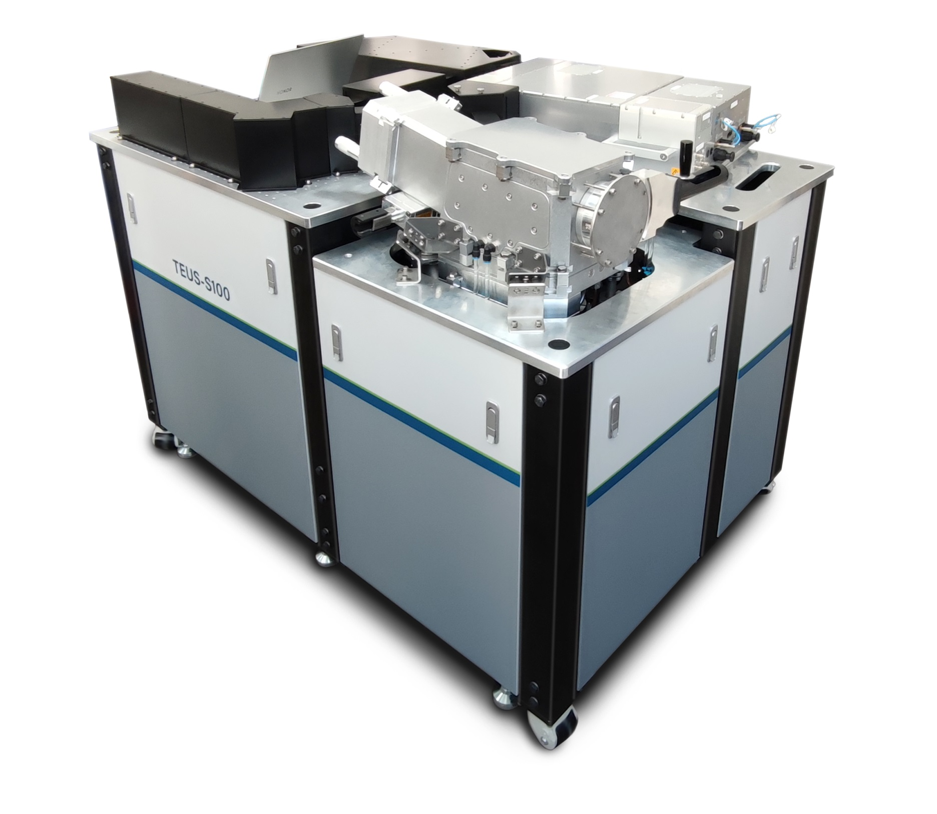
EUV light sources
TEUS-S100

Slide 20
EUV light sources
TEUS-S100
EUV light source product specifications
Main Specifications
Laser average power | 100W
Maximum pulse repetition rate | 25kHz
Solid angle of collectable EUV power | 0.05sr
Conversion efficiency in-band (13.5 nm±1%) radiation | 2% @2π·sr
ЕUV flux inside collection angle after debris mitigation system in-band (13.5nm±1%) | 8.5mW
Spectral brightness after debris mitigation system in-band (13.5nm±1%) | 90W/mm²·sr
Plasma size* | 60um
Plasma stability** | 3% RMS
System Lifetime and Maintenance Requirements
Collector lifetime with degradation of 10% without using a special membrane filter in 24/7 mode of operation | not less than 8 months
Collector lifetime with degradation of 10% using a special membrane filter in 24/7 mode of operation | not less than 18 months
Maintenance time every 4 month | 1 day
Uptime in 24/7 mode of operation*** | 4 months
Electrical Power, System Dimensions and Weight
Electrical power | 6.5 kW
Dimensions (L×W×H) | 1400×1000×1200mm
Weight, including laser components | 770Kg
Facility Requirements
Room cleanliness class | ISO7
Water flow rate | 10L/min
* : 1/e² ** : determined mainly by laser stability *** : with shutting off the EUV beam for 5mins every 2 months for membrane magazine replacement For full-band (13.5nm ± 2%) conversion efficiency is 4%@2π, giving double brightness and double the collected EUV power.

Slide 21
EUV light sources
TEUS-S200
EUV light source product specifications
Main Specifications
Laser average power | 200W
Maximum pulse repetition rate | 50kHz
Solid angle of collectable EUV power | 0.05sr
Conversion efficiency in-band (13.5 nm±1%) radiation | 2% @2π·sr
ЕUV flux inside collection angle after debris mitigation system in-band (13.5nm±1%) | 17mW
Spectral brightness after debris mitigation system in-band (13.5nm±1%) | 180W/mm2·sr
Plasma size* | 60um
Plasma stability** | 3% RMS
System Lifetime and Maintenance Requirements
Collector lifetime with degradation of 10% without using a special membrane filter in 24/7 mode of operation | not less than 4 months
Collector lifetime with degradation of 10% using a special membrane filter in 24/7 mode of operation | not less than 9 months
Maintenance time every 3 months | 1 day
Uptime in 24/7 mode of operation*** | 2 months
Electrical Power, System Dimensions and Weight
Electrical power | 8.5kW
Dimensions (L×W×H) | 1400×1000×1300mm
Weight, including laser components | 770Kg
Facility Requirements
Room cleanliness class | ISO7
Water flow rate | 15L/min
* : 1/e2 ** : determined mainly by laser stability ***: with shutting off the EUV beam for 5mins every month for membrane magazine replacement For full-band (13.5nm ± 2%) conversion efficiency is 4%@2π, giving double brightness and double the collected EUV power.

Slide 22
EUV light sources
TEUS-S400 product
EUV light source product specifications
Main Specifications
Laser average power | 400W
Maximum pulse repetition rate | 100kHz
Solid angle of collectable EUV power | 0.05sr
Conversion efficiency in-band (13.5 nm±1%) radiation | 2% @2π·sr
ЕUV flux inside collection angle after debris mitigation system in-band (13.5nm±1%) | 34mW
Spectral brightness after debris mitigation system in-band (13.5nm±1%) | 360W/mm²·sr
Plasma size* | 60um
Plasma stability** | 3% RMS
System Lifetime and Maintenance Requirements
Collector lifetime with degradation of 10% without using a special membrane filter in 24/7 mode of operation | not less than 2 months
Collector lifetime with degradation of 10% using a special membrane filter in 24/7 mode of operation | not less than 4 months
Maintenance time every 2 months | 1 day
Uptime in 24/7 mode of operation*** | 1 months
Electrical Power, System Dimensions and Weight
Electrical power | 10.5 kW
Dimensions (L×W×H) | 1400×1000×1400mm
Weight, including laser components | 770Kg
Facility Requirements
Room cleanliness class | ISO7
Water flow rate | 25L/min
* : 1/e2 ** : determined mainly by laser stability ***: with shutting off the EUV beam for 5mins every 2 weeks for membrane magazine replacement For full-band (13.5nm ± 2%) conversion efficiency is 4%@2π, giving double brightness and double the collected EUV power

