Slide 1
Innovative lasers
Introduction: by Andrius Rinkevicius, CEO
Quantum Light Instruments Ltd.

Slide 2
Contents
Introduction
QLI technology overview. QLI product lines.
Our customers and applications. Contact information.
●
●
●
●
●

Slide 3
QLI: Introduction
Founded in May of 2014, in Vilnius, Lithuania. Employees: team of 9 persons (September of 2021).
More than 50 years accumulated experience in laser development, production and service.
Introduced Quantas series lasers in October of 2014. First laser delivered: March of 2015.
In year 2020 we delivered ~50 laser systems, with turnover of 941 kEUR, 20% increase from year 2019.
●
●
●
●
●
●

Slide 4
What we are doing?
●
We are designing and producing compact, air-cooled (water-free), passively or actively Q-switched, diode-pumped solid-state lasers and accessories for them (harmonics generators, OPOs, attenuators etc).
We are ahead of competition: the only company delivering of water-free Q-switched laser with 120 mJ pulse energy, and up to 5 W average power.
●

Slide 5
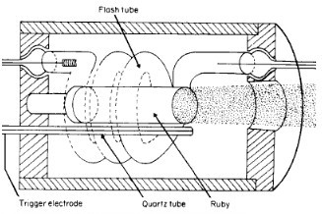
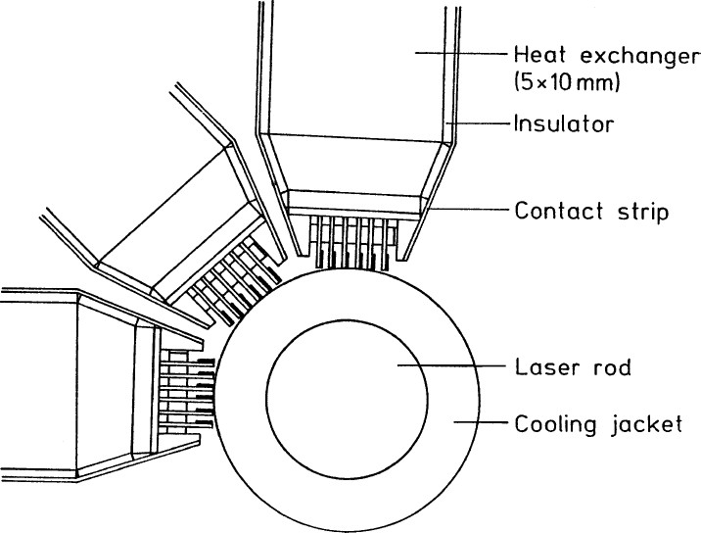
From flashlamp to diode pumping
Theodore H. Maiman, 1960: First flashlamp pumped laser
2000’s: flashlamp replaced by laser diode
With side (flashlamp) pumping, heat transfer is done with help of the liquid coolant, transparent to the pump radiation. With no water rep rates would be limited to ~0.25 Hz ( in National Ignition Facility – 1 shot in 8 hours) for flashlamp pumped laser, and ~1 Hz for diode pumping.

Slide 6
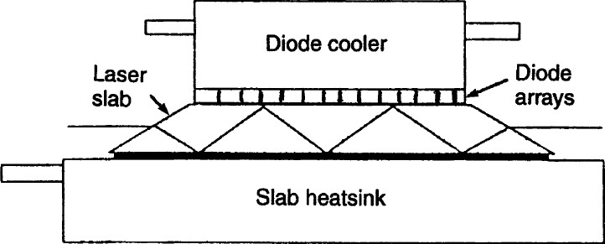
Water-free pumping: overview
Side pumping with slab geometry, no axial symmetry, poor beam quality
End-pumping: all laser crystal side surface available for heat transfer

Slide 7
QLI pumping setup
●
LD – laser diode array, BSS - pump beam shaping system, RM – rear mirror, LR – laser rod, heatsink mounted, P1 – polariser, QSW – Q-switch cell, OC – output coupler.
●
Up to 2 kW pump peak power can be coupled to the rod with >90% efficiency.
●
High single pass gain – like in flashlamp pumped systems.

Slide 8
Our technology advantage
All our lasers use water-free, end-pumped laser crystal cooling technology, invented by QLI.
– Much better beam focusability than our competitors – easy to focus to small spot.
Short pulse duration in 750 ps -8 ns range (in laboratory : down to 500 ps).
Energy efficient ( typical power consumption <100W, some models ~10 W) - advantage for portable, multichannel systems. By factor of ~10 better than flashlamp pumped lasers.
No water inside: it is real turn key system.
–
–
–

Slide 9
Pushing our technology limits
●
>5W average power, >120 mJ pulse enegy produced.
Wavelength range from 210 nm – 4.5 µm.
Development ongoing for up to 10 W average power… 200 mJ at 50 Hz.
●
●

Slide 10
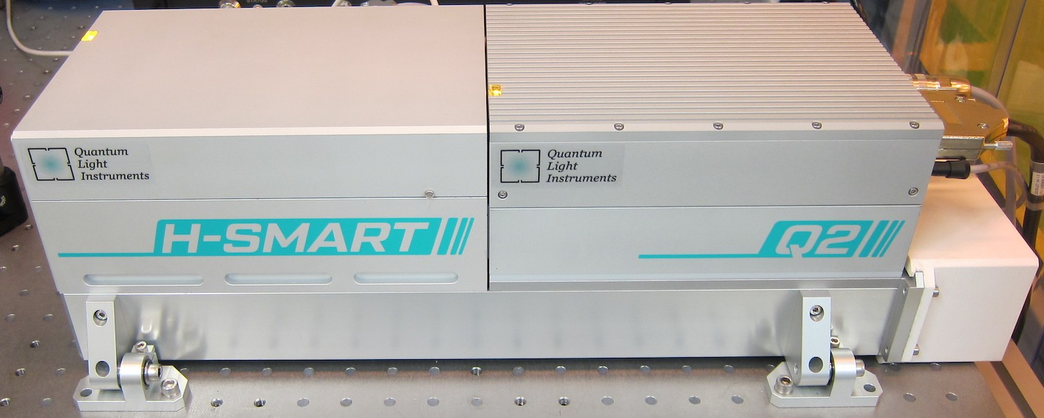
Customizations
●
Water-cooled heatsink for laser integration into tight spaces with limited airflow.
Integrated AC/DC converter, controller, air-purging as 19” rack of 3U height module.
Adaptation for car battery (13.7 V or 27.4 V) powering.
High efficiency heatsink with HEPA filtered air flow for clean room environment (also mounted on common baseplate with H-SMART).
●
●
●

Slide 11
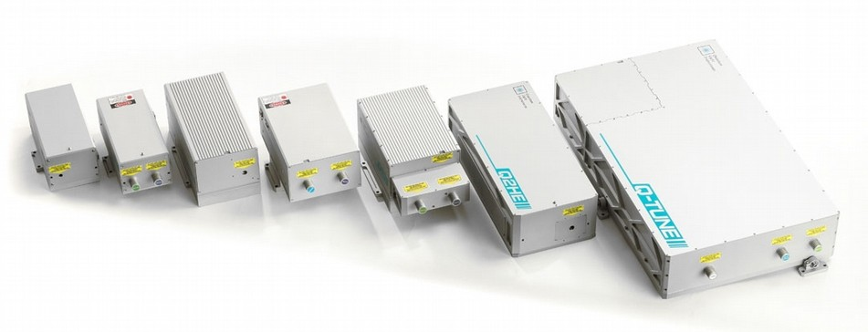
Product lines

Slide 12
Updated product families
●
Q1 – most compact, up to ~500 mW, up to 50 mJ.
Q2 – sligtly larger body, up to 2.5W, up to 80 mJ.
Q2HE – sealed body, up to 4W, up to 120 mJ. Q-SPARK – short pulse, ~750 ps, >5 mJ.
H-SMART – self-tuning, motorized harmonic generator, up to 5th harmonic.
Q-TUNE – all-in-one OPO system.
●
●
●
●
●

Slide 13
Introduced recently
Q-SHIFT laser family – wider range of wavelengths, 2
– 5 ns, up to 50 mJ, up to 100 Hz.
Q-TUNE-IR – laser radiation in infrared range, 1380 – 4500 nm.
Q-TUNE-G - laser radiation in near-infrared range, 700 – 2300 nm, peak at 750 nm.
Q-DOUBLE – two pulses with variable temporal separation, up to 200 mJ, up to 200 Hz.
Fiber Couplers – precise coupling alignment, for up to 5th harmonics.
●
●
●
●
●

Slide 14
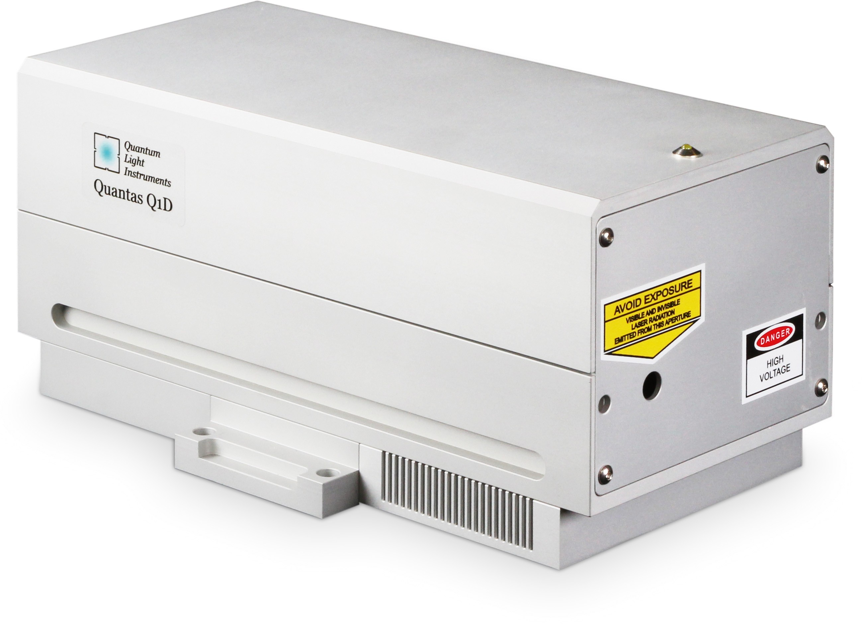
All our lasers have similar design...
Electronics
Laser cavity Cooling system

Slide 15
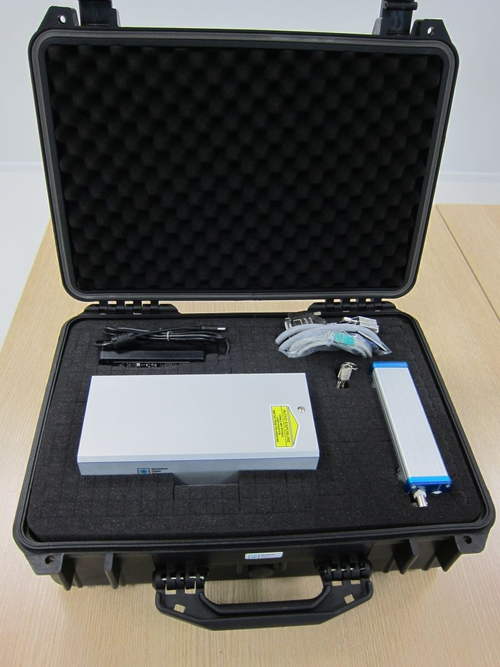
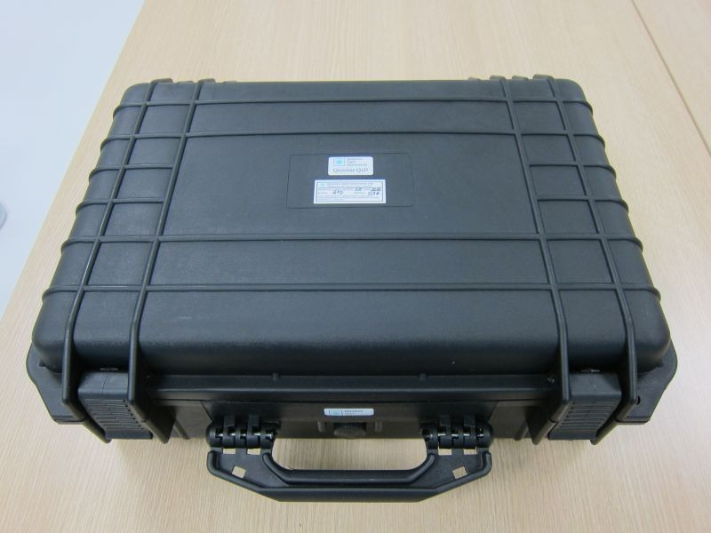
Compact packaging
Q1 series laser is ready for shipment.

Slide 16
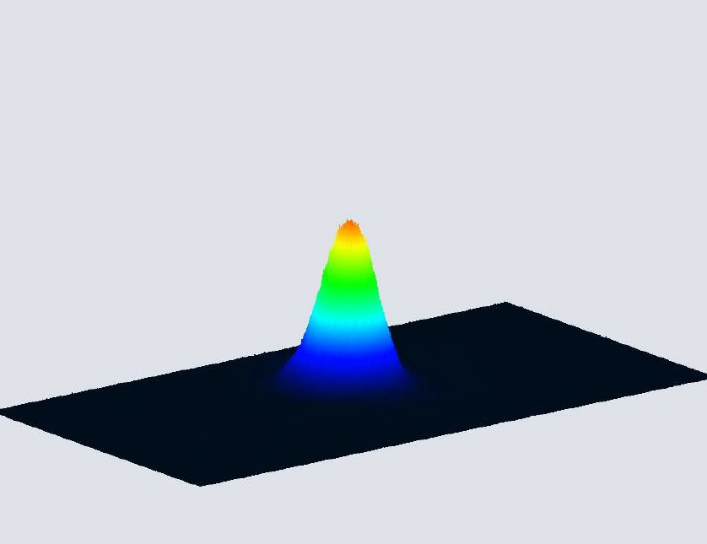
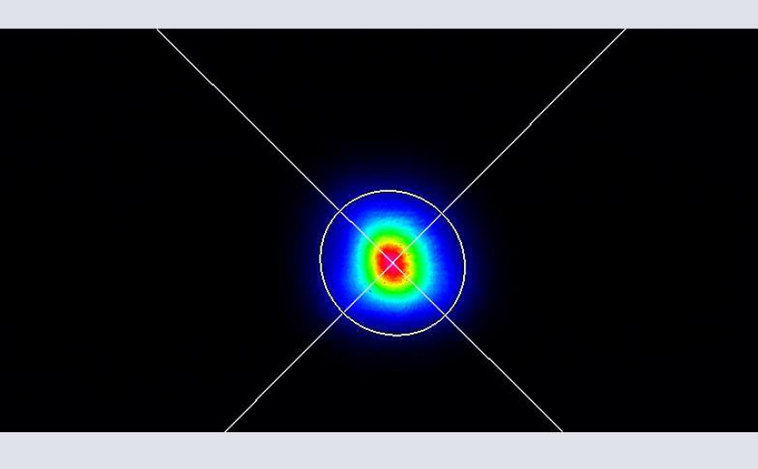
Q1 series beam profiles
Q1B lasers produce nearly TEM00 beam profile output and has good beam focusability (M2 <2). Example of Q1B beam profile is shown on the right.
Q1C and Q1D have bell-shaped beam profile with M² <2 (resulting in fifth harmonics generation efficiency up to 10% from fundamental).
Q1-B10-1064 near field beam profile

Slide 17
Q2 and Q2HE
●
Designed to operate at higher repetition rates (20-100 Hz) in comparison to Q1.
Q2 model is integrated into our OPO system, together with H-SMART harmonic generator.
Q2HE is high pulse energy version, in addition, designed for harsh environments with high temperature or/and humidity.
●
●

Slide 18
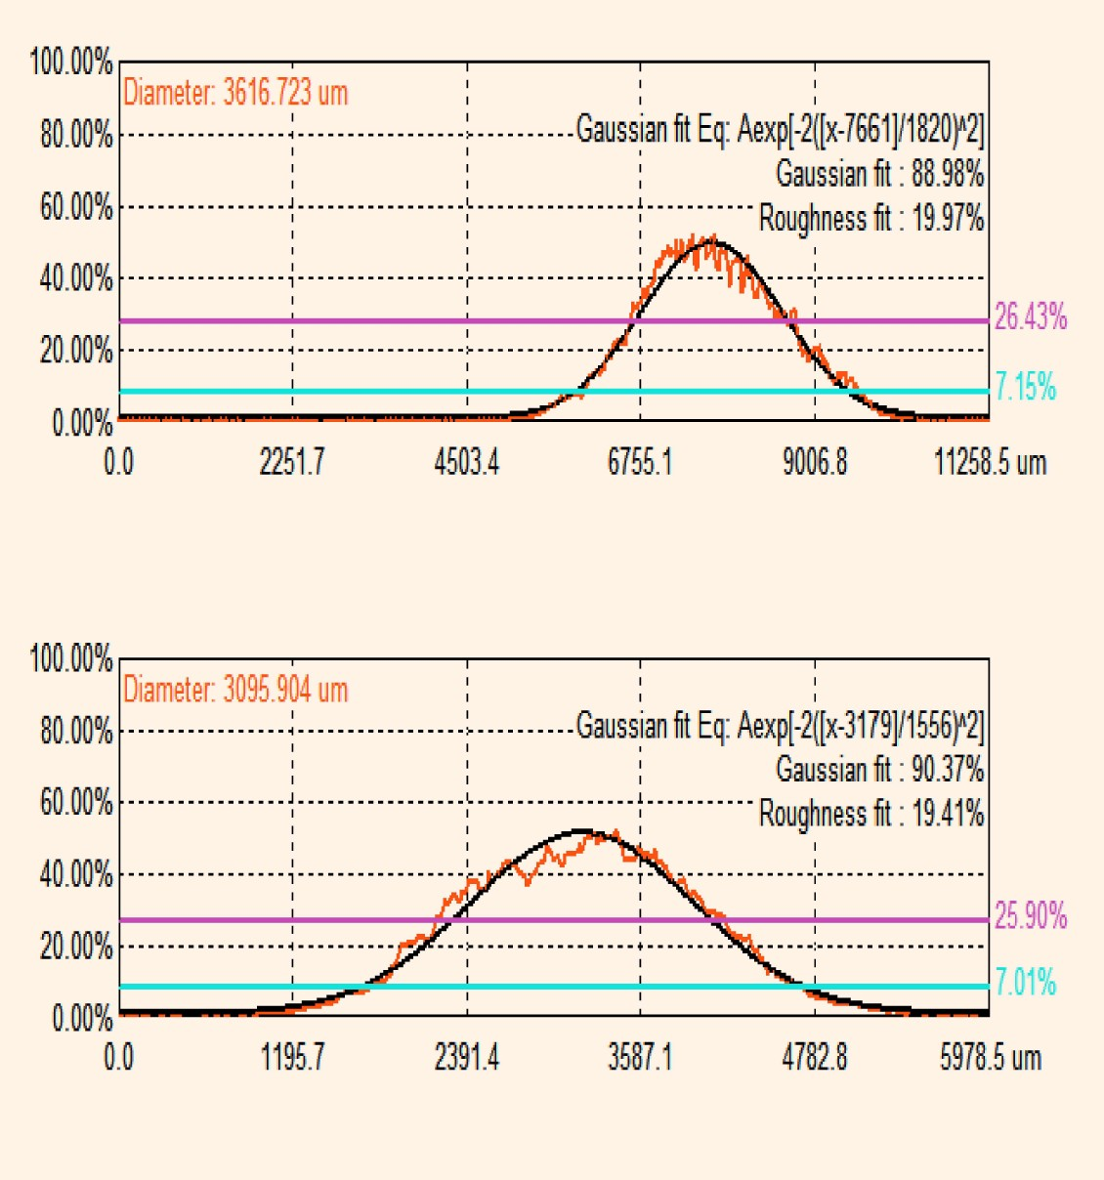
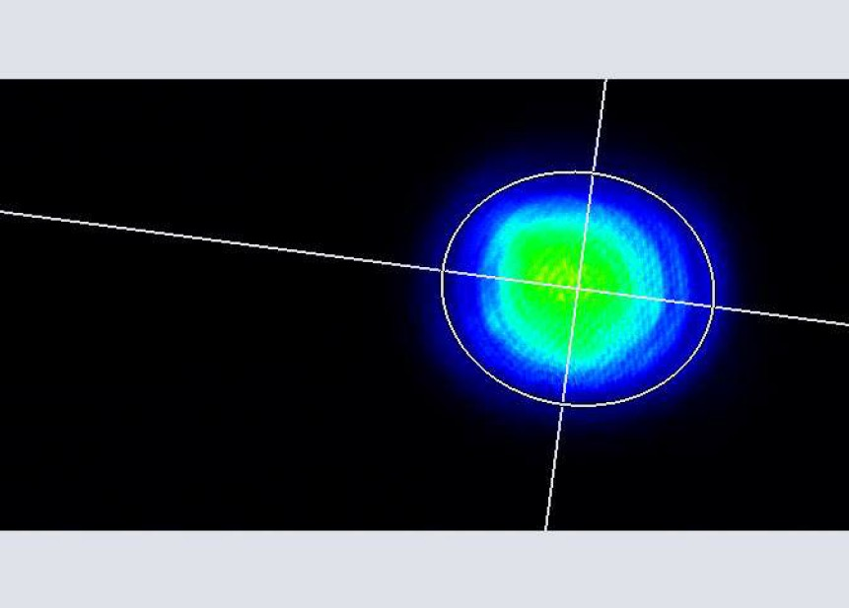
Typical near field beam profiles
TEM₀₀-like beam with Gaussian fit >85%

Slide 19
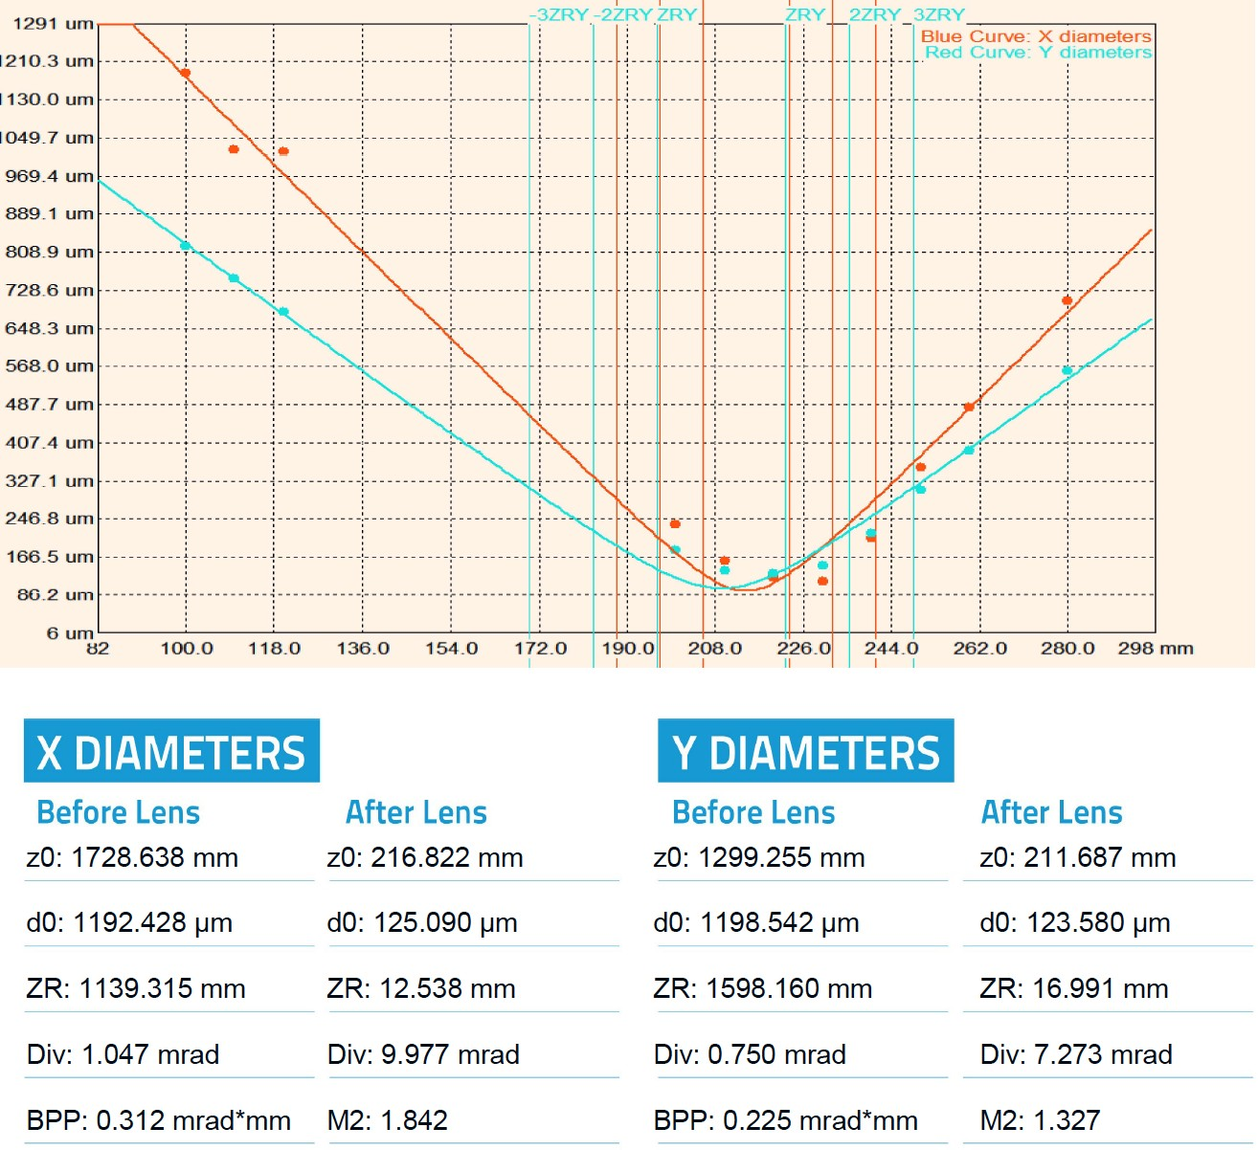
Focusability, M2 factor
●
Specified M2 <2, typical measurement shows it in 1.3-1.5 range.

Slide 20
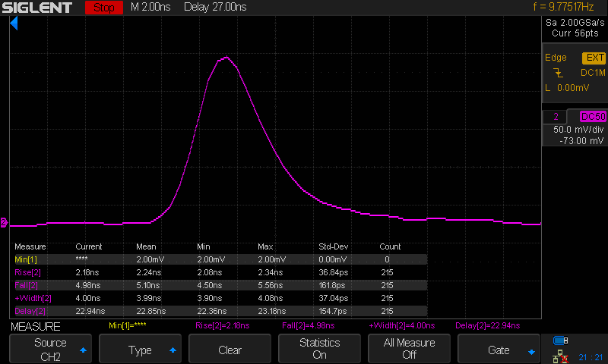
Pulse waveforms
FWHM = 4 ns

Slide 21
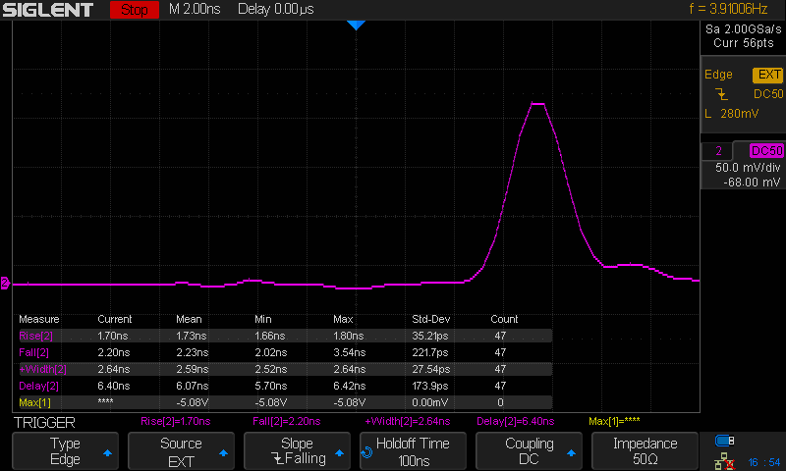
Pulse waveform – 2.5 ns version
Measured with 300 MHz
oscilloscope, FWHM = 2.59
ns, rise and fall edges almost the
same

Slide 22
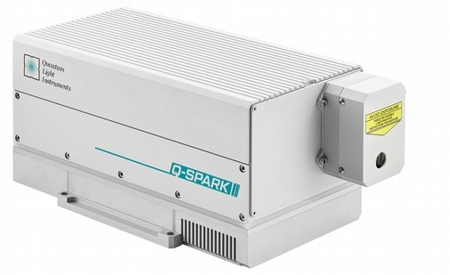
Q-SPARK
●
As short as possible pulse duration from Q-switched system: <800 ps @ 1064nm for Q-SPARK-A10PS
model, in 1.1-1.5 ns range typically for other models.
Optional build-in 2nd, 3rd or 4th harmonics generator. Size of housing does not change, there is reserved space or crystals and beam separators.
High pulse energy > 20 mJ @1064 nm from compact package (275 x 140 mm footprint).
Optional attenuator and pulse energy monitor.
●
●
●

Slide 23
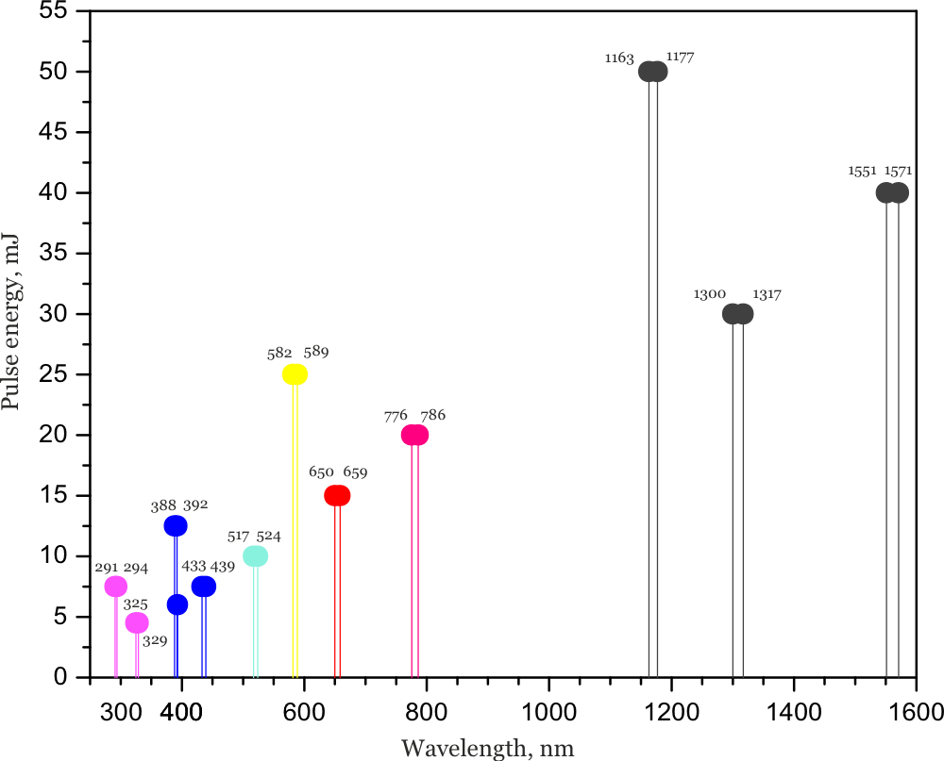
Q-SHIFT

Slide 24
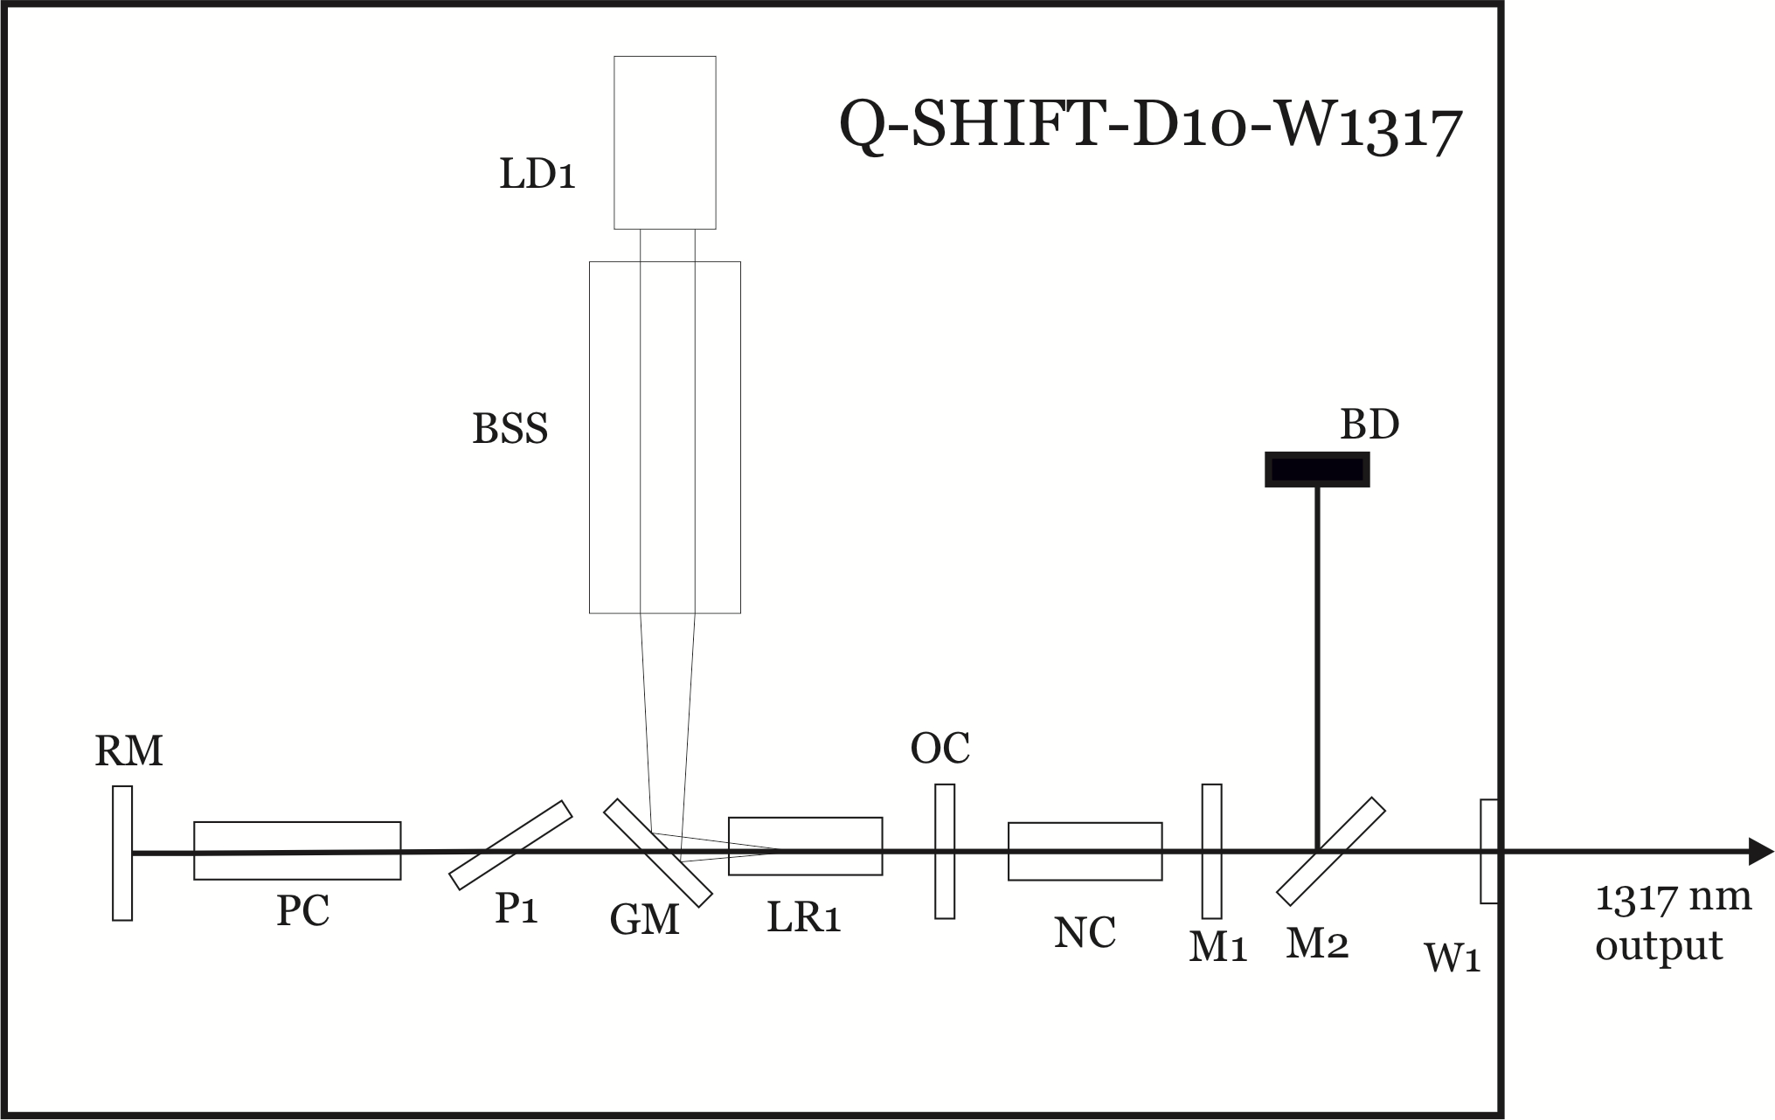
Principle of operation
●
Wavelength converter integrated together with pump laser into single housing (Q2 or Q2HE type).

Slide 25
Principle of operation
For conversion Raman crystal or OPO crystal is used, depending on wavelength.
Price of Q-SHIFT laser adds from pump laser price and wavelength converter price.
Optional H-SMART harmonic generators extends wavelength into red, yellow, blue and even UV range.
●
●
●

Slide 26
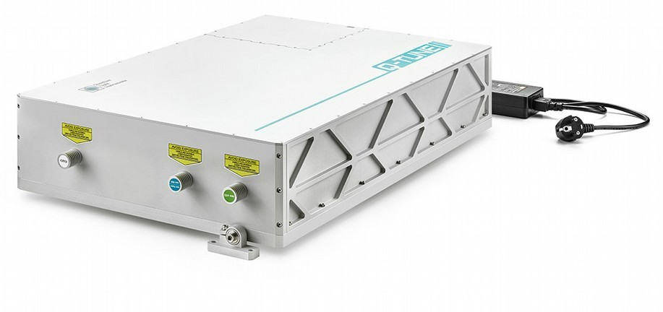
Q-TUNE all-in-one OPO system

Slide 27
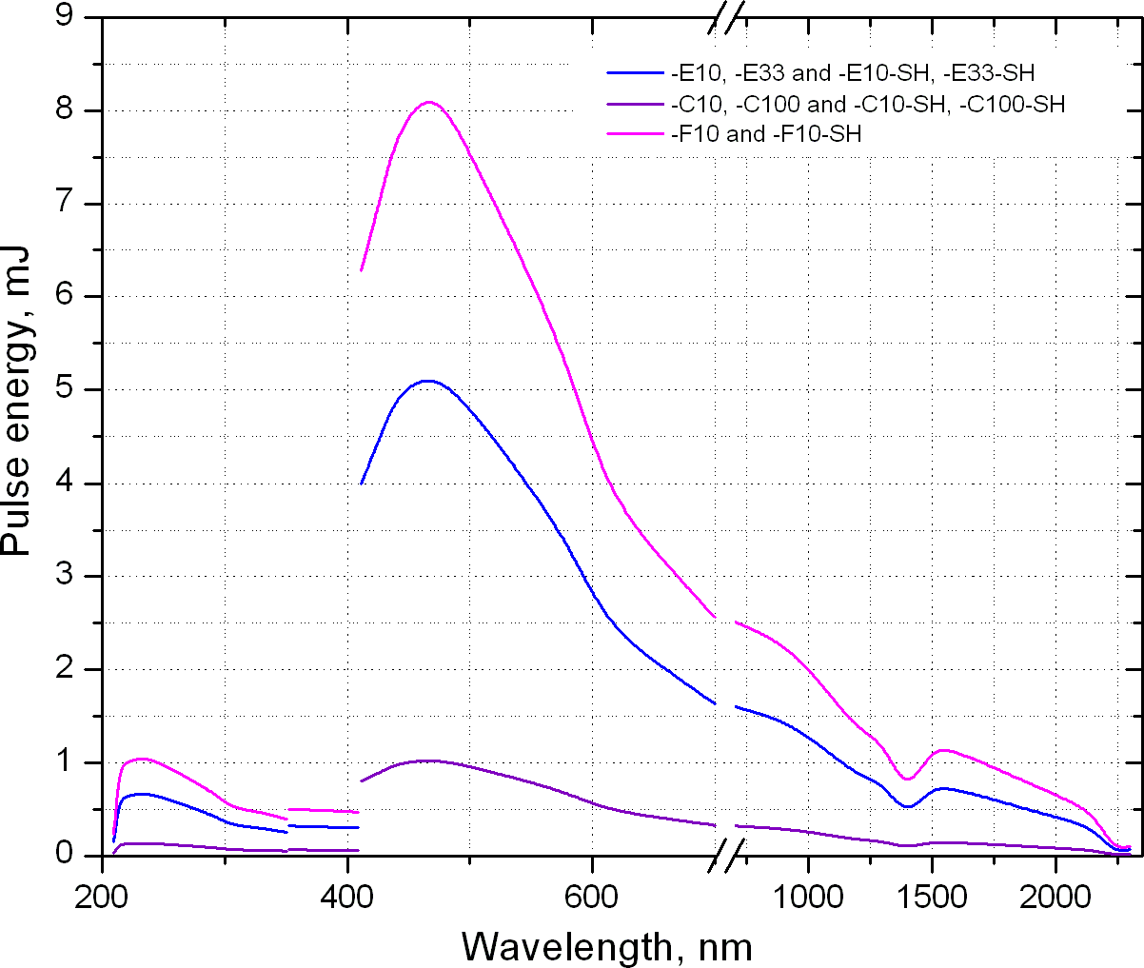
Q-TUNE tuning curve

Slide 28
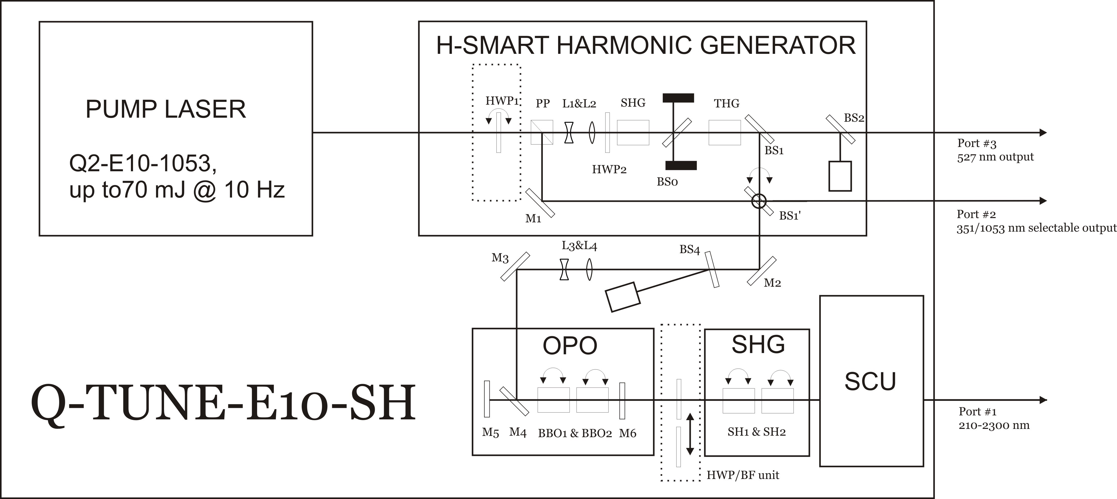
What is inside the box?
Optical layout can be customized with fiber coupling tunable beam, wavelength monitoring, pulse energy monitoring

Slide 29
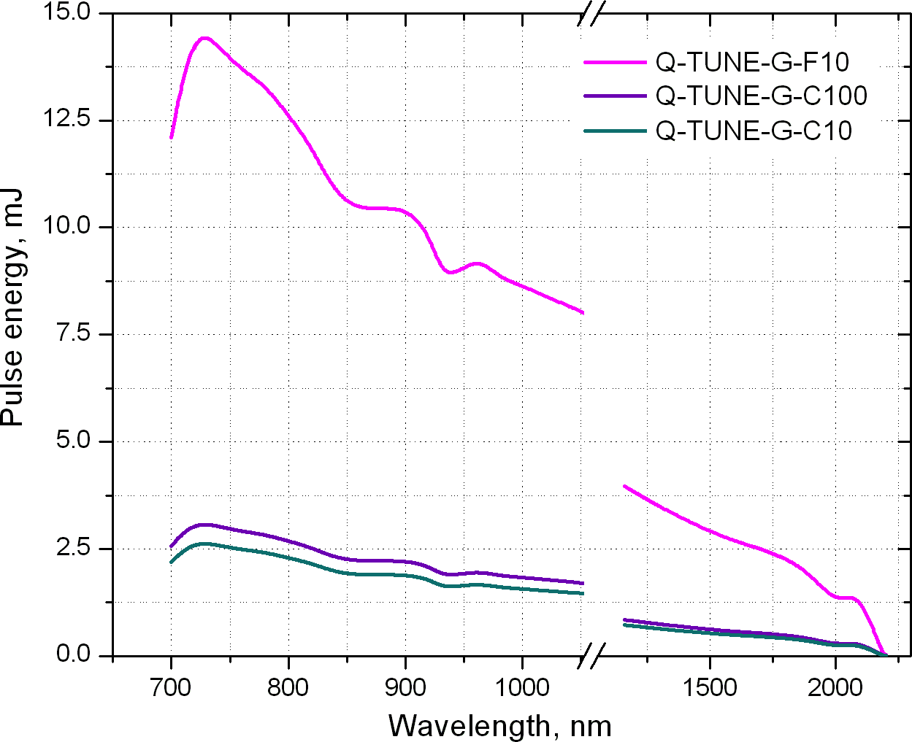
Q-TUNE-G
●
Laser radiation in the near-infrared range, 700 – 2300 nm.
3 – 4 ns, >12 m J
at the peak tuning curve, up to 20 Hz.
Linewidth of <20 cm⁻¹, broadband version ~200 cm⁻¹
●
●

Slide 30
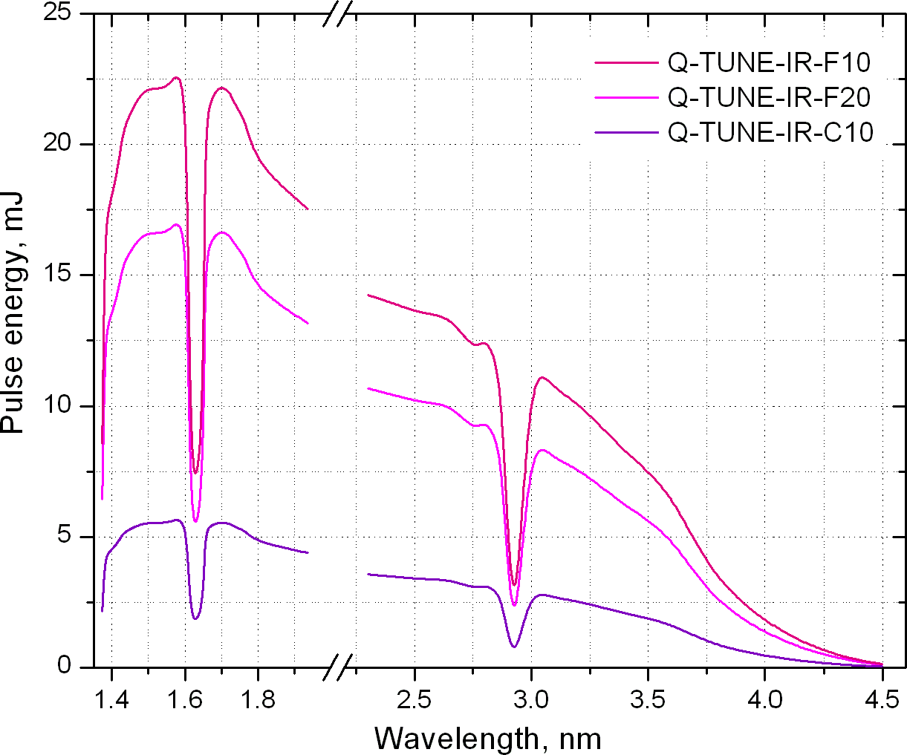
Q-TUNE-IR
●
Laser radiation in the infrared range, 1380 – 4500 nm.
3 – 4 ns, >15 m J
at the peak tuning curve, up to 20 Hz.
Linewidth of <10 cm⁻¹, broadband version ~200 cm⁻¹
●
●

Slide 31
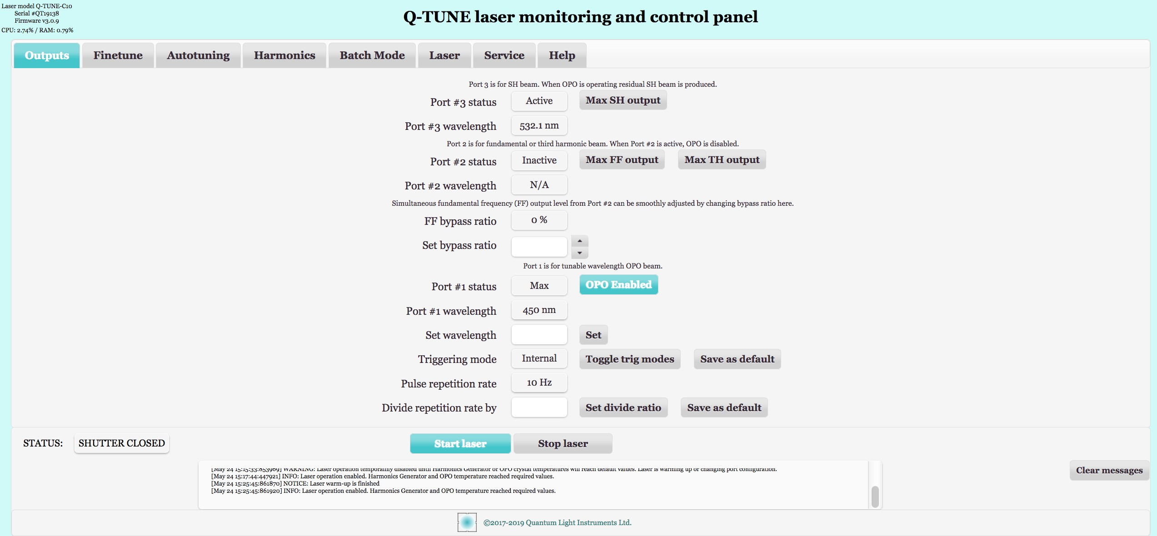
Software control
Laser is controlled via its web interface, with simple text-based queries

Slide 32
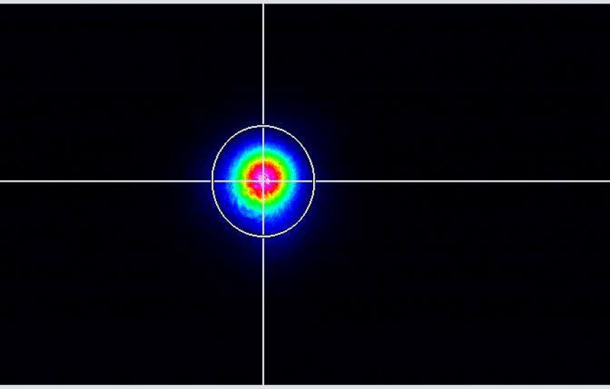
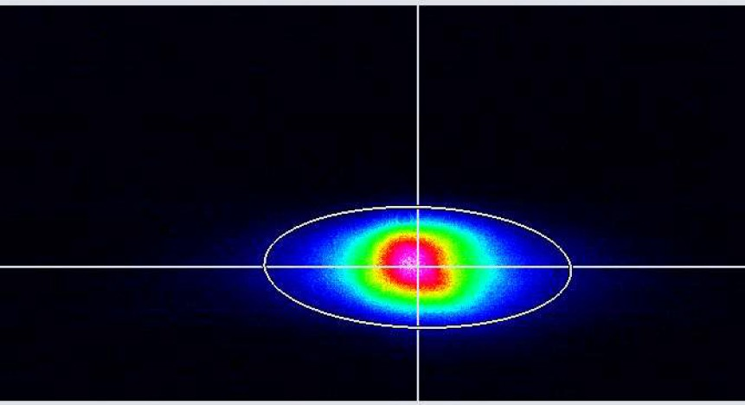
Beam profiles ( 1 mJ version)
Beam profile of pump laser @1064 nm
Beam profile @450 nm

Slide 33
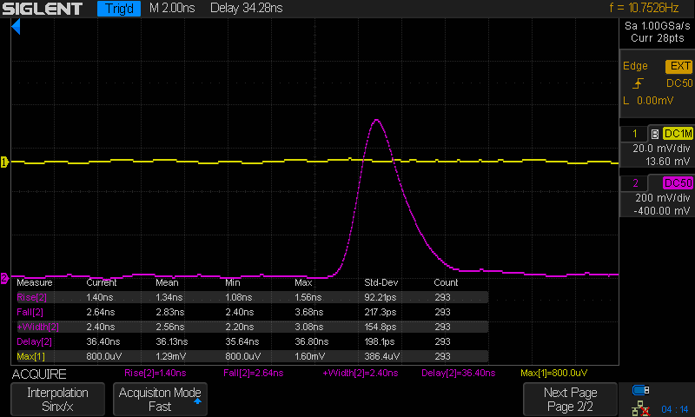
Pulse waveform
Pulse waveform at 450 nm, FWHM = 2.56 ns

Slide 34
Our customers
Almost 100% of our lasers are exported.
Our lasers operate at top level laboratories around the world:
●
●
– Lawrence Livermore National Laboratory (USA); Los Alamos National Laboratory (USA);
Sandia National Laboratory (USA); Brookhaven National Laboratory (USA); Japan Atomic Energy Agency (Japan);
Shanghai Institute of Optics and Fine Mechanics (China); Fraunhofer Institute (Germany);
and many others...
–
–
–
–
–
–
–

Slide 35
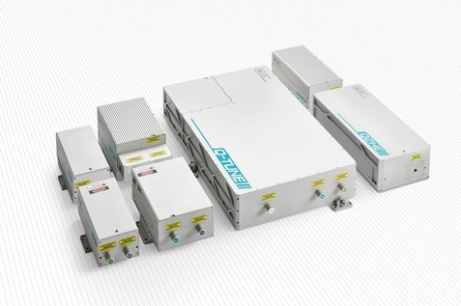
Applications
Light Induced Breakdown Spectroscopy (LIBS).
Laser ablation (marking, LCD
repair etc.)
Laser shock wave generation.
Time-of-Flight Spectroscopy (TOFS).
Light Induced Fluorescence (LIF) Spectroscopy.
Flash photolysis.
Pulsed light deposition (PLD).
Remote sensing (LIDAR etc.).
Laser designation (military).
Ophthalmology (medical).

